Slide 1
Genome-wide association studies (GWAS)
Dr. K.Sangeetha

Slide 2
Complex and Simple trait
Complex traits or polygenic trait are believed to result from variation within multiple genes and their interaction with behavioral and environmental factors. Complex traits do not follow readily predictable patterns of inheritance
Examples of complex traits include disorders such as autism, cardiac disease, cancer, diabetes, Alzheimer's disease, and asthma
Complex traits are those that are influenced by more than one factor. The factors can be genetic or environmental. This is in contrast to simple genetic traits, whose variations are controlled by variations in single genes. Examples of simple traits include Huntington's disease and cystic fibrosis
A polygenic trait is a characteristic, such as height or skin color, that is influenced by two or more genes. Because multiple genes are involved, polygenic traits do not follow the patterns of Mendelian inheritance. Many polygenic traits are also influenced by the environment and are called multifactorial.
Complex or quantitative traits are important in medicine (e.g. diabetes), agriculture (e.g. yield of rice) and evolution (e.g. body size)

Slide 3
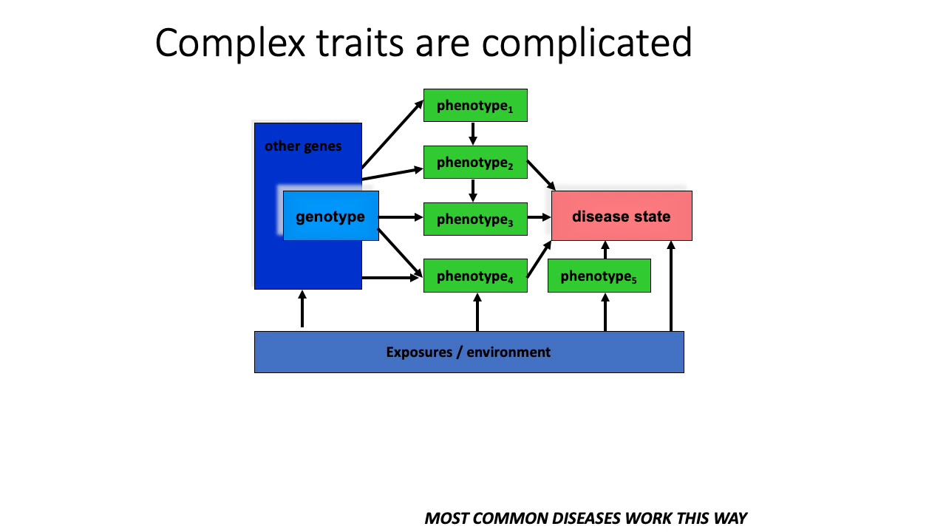

Slide 4
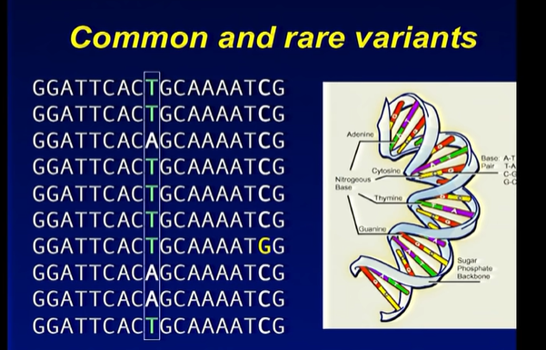
Common and rare variants
GWAS are good at identifying common variants in the complex traits
GWAS involve targeted genotyping of specific variants using microarrays or capture all variants by whole exome and whole-genome sequencing (WES, WGS)
Declaring variant as common/rare is population-specific; not general across populations
Common variants are those with a minor allele frequency above 10% (as population sizes grow this threshold can be as low as 1%)
Researchers typically adhere to a minimum minor allele count (for example, at least 100 individuals who carry at least one copy of the minor allele)

Slide 5
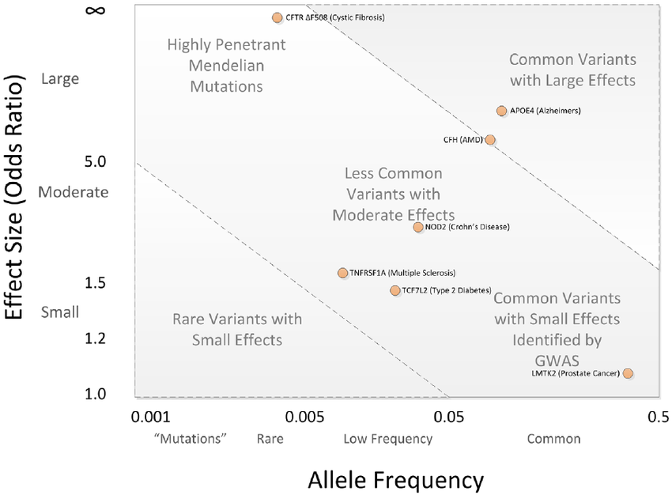
GWAS: Spectrum of disease allele effects (a common disease–common variant (CD–CV) hypothesis)
Disease associations are often conceptualized in two dimensions
Allele frequency and effect size
GWAS is good to detect alleles that have small effect but common occurrence (example: prostrate cancer)
Super rare mutations but have large effect sizes (Qualitative traits):
Most risk variants identified by GWAS lie within the two diagonal lines.
Note: Penetrance is the percentage of animals of a specific genotype who express the phenotype associated with that underlying genotype.
Expressivity refers to the degree that a particular genotype is expressed as a phenotype within an individual

Slide 6
GWA Studies
Benefits of GWA vs Classical Mapping
More powerful vs linkage for common, low penetrance variants
Better resolution than linkage
No need to select candidate genes
Requirements of GWAS
Catalogue of human variants
Low cost, accurate method for genotyping
Large number of informative samples
Efficient statistical design and analysis

Slide 7
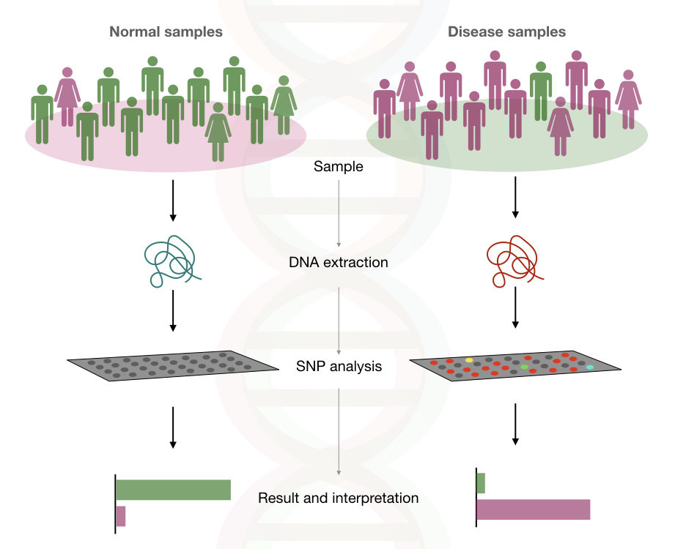
Goals of GWAS
To test large portion of common single nucleotide genetic variation in the genome for association with a disease or variation in a quantitative trait
Find disease/quantitative trait-related variants without a prior hypothesis of gene function

Slide 8
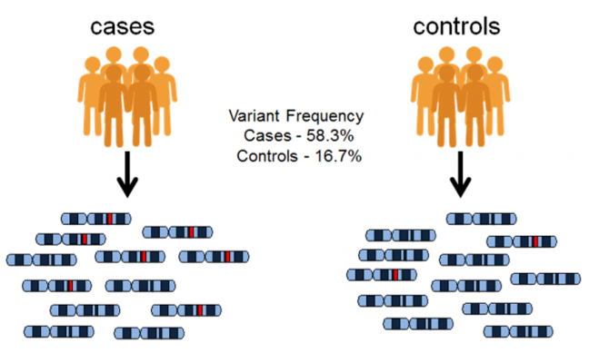
Another definition
Goal of GWAS: To predict either disease risk or disease progression by identifying genetic factors that define biological basis of the disease
Diseases chosen are complex traits
Principle: Association of phenotypic variation with genotypic variation

Slide 9
Introduction to GWAS
Genome-wide association studies (GWAS) aim to identify associations of genotypes with phenotypes by testing for differences in the allele frequency of genetic variants between individuals who are ancestrally similar but differ phenotypically
Most commonly studied genetic variants in GWAS are single-nucleotide polymorphisms (SNPs)

Slide 10

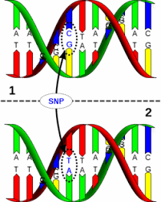
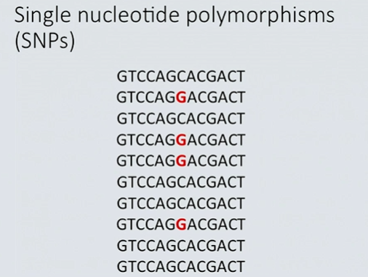
Hunt is for SNPs (call it “Snips”)
GWAS studies the entire set of DNA (the genome) of a large group of people, searching for small variations, called single nucleotide polymorphisms or SNPs
SNPs are places in the genome that are known to vary between individuals and can be associated with a particular disease
GWAS typically report blocks of correlated SNPs that all show a statistically significant association with the trait of interest, known as genomic risk loci

Slide 11
Applications of GWAS
Trait-associated genetic variants can be used as control variables in epidemiology studies to account for confounding genetic group differences
Predict an individual’s risk for physical and mental disease based on their genetic profile (Polygenic risk scores (PRS) for coronary artery disease, atrial fibrillation, type 2 diabetes, inflammatory bowel disease and breast cancer can identify disease risk as well as monogenic risk prediction strategies based on rare, highly penetrant mutations

Slide 12
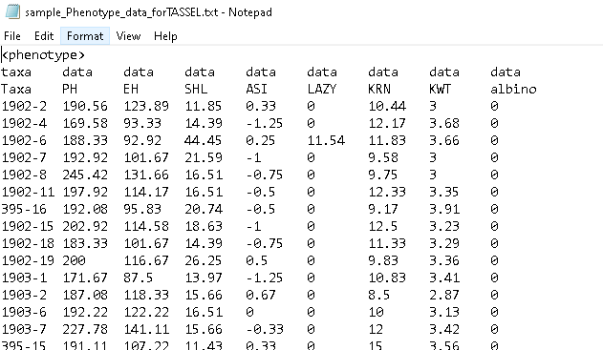
Phenotype
Disease i.e., dichotomous
(Case/Control)
Rare
Common
Quantitative trait
Easy to measure: Weight, height
Requires testing: Coronary artery thickness
Requires experiment: Gene expression

Slide 13
Strategy: Case and Control
Case: set of individuals with the disease or characteristic being studied
Control: set of people who are similar to the first set but who do not have the disease or characteristic being studied
Population survey and extreme phenotype for cases
The participants provide a blood sample or cheek swab from which their DNA can be extracted. Their genome is then analyzed, commonly using a SNP-chip, to look at several hundred thousand SNPs across the genome. The two groups are then compared to see if there are any specific SNPs that are more common in one group compared to the other

Slide 14
Selection of cases
Potential criteria to enrich genetic effect size
More severely affected individuals
Require other family member to have the disease
Younger age-of-disease onset
Selection of controls
Potential criteria to enrich genetic effect size
Low risk of disease rather than population-based samples
Same ancestry as cases
Matched to cases on age, sex and demographics

Slide 15
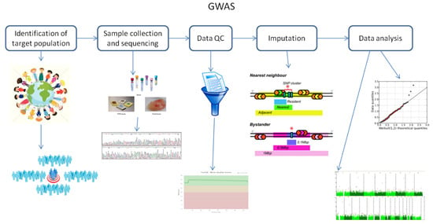
Basic workflow in GWAS
Study design
Sample collection
Genotyping
Quality control
Statistical analysis
Replication

Slide 16
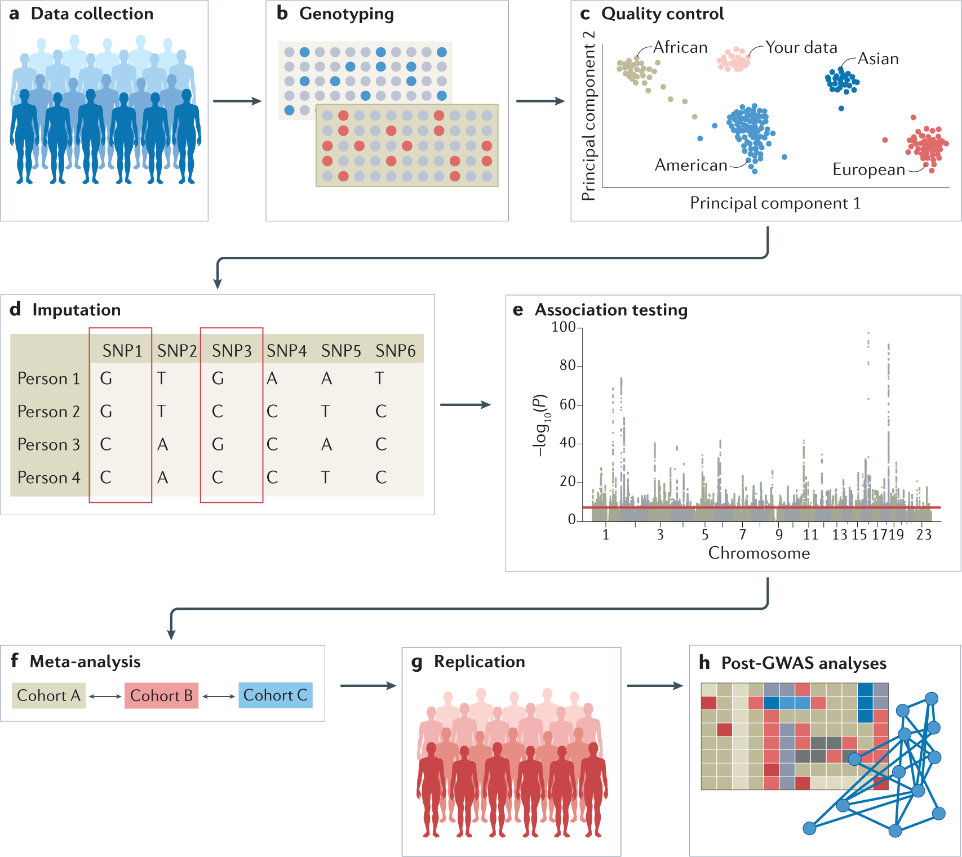
Data collected from study cohorts/available genetic and phenotypic information from biobanks/repositories. Confounders must be carefully considered; recruitment strategies must not introduce biases such as collider bias
Genotypic data collected using microarrays to capture common variants, or next-generation sequencing methods for whole-genome sequencing (WGS)/whole-exome sequencing (WES)
Quality control includes steps at the wet-laboratory stage, such as genotype calling and DNA switches, and dry-laboratory stages on called genotypes, such as deletion of bad single-nucleotide polymorphisms (SNPs) and individuals, detection of population strata in the sample and calculation of principle components Figure depicts clustering of individuals according to genetic substrata.
Genotypic data can be phased, and untyped genotypes imputed using information from matched reference populations from repositories such as 1000 Genomes Project or TopMed. In this example, genotypes of SNP1 and SNP3 are imputed based on the directly assayed genotypes of other SNPs.
Genetic association tests are run for each genetic variant, using appropriate model (example, additive/non-additive, linear/logistic regression). Confounders are corrected for, including population strata, and multiple testing needs to be controlled. Output is inspected for unusual patterns and summary statistics are generated.
Results from multiple smaller cohorts are combined using standardized statistical pipelines
Results can be replicated using internal replication or external replication in an independent cohort. For external replication, the independent cohort must be ancestrally matched and not share individuals or family members with discovery cohort
n silico analysis of GWAS, using information from external resources. This can include in silico fine-mapping, SNP to gene mapping, gene to function mapping, pathway analysis, genetic correlation analysis, Mendelian randomization and polygenic risk prediction. After GWAS, functional hypotheses can be tested using experimental techniques such as CRISPR or massively parallel reporter assays, or results can be validated in a human trait/disease model (not shown).

Slide 17
Selecting Study populations
Large sample size (determined by software tools: CATs and GPC)
Study design: case/control or quantitative
Other design: Population-based and family-based designs
Recruitment strategies must be considered not to induce collider bias
Input files for a GWAS include anonymized individual ID numbers, coded family relations between individuals, sex, phenotype information, covariates, genotype calls for all called variants and information on the genotyping batch
Sample collection
To detect smaller and smaller effects, larger and larger sample sizes are considered
Smaller the odds ratio (Effect size, greater the sample size)
Note: Collider bias
A bias that occurs when two variables (A and B) both influence a third variable (C), and the third variable is used to condition on. This can induce spurious correlations between variables A and B

Slide 18
Data source
Choice of data resource and study design for GWAS depends on the required sample size, the experimental question and the availability of pre-existing data or the ease with which new data can be collected
Research cohorts such as the UK Biobank recruit participants through a volunteer-based strategy (which results in participants who are, on average, healthier, wealthier and more educated than the general population)
Cohorts that enroll participants from hospitals based on their disease status (such as BioBank Japan)
Different ethnicities can be included in the same study, as long as the population substructure is considered to avoid false positive results

Slide 19
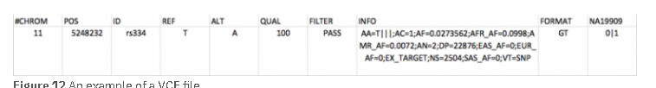
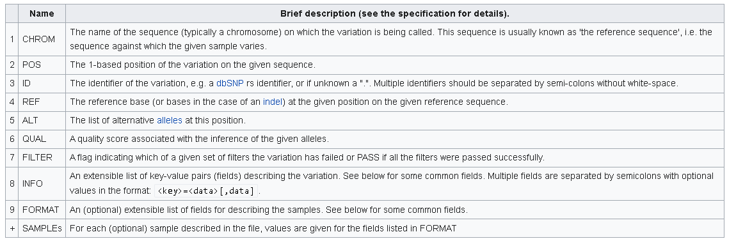
Data formats
Variant Call Format: standard format for storing variation data
Is a standard output of variant calling software such as the GATK and standard input for tools such as VEP or EVA. It is unambiguous, scalable and flexible, can store millions of variants. VCF is a text file used for representing SNP, indel, and structural variation calls.
Header
Provides metadata describing body of the file
Starts with #
Keywords: fileformat, fileDate and reference
Can also contain keywords that describe fields used in the body
Body
Tab separating 8 mandatory columns and unlimited optional columns

Slide 20
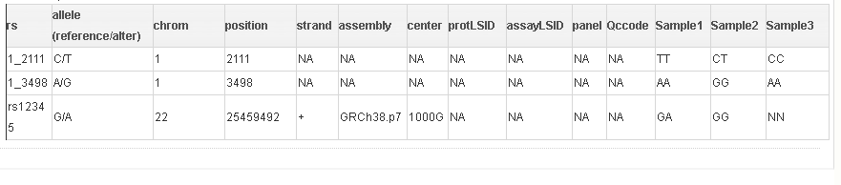
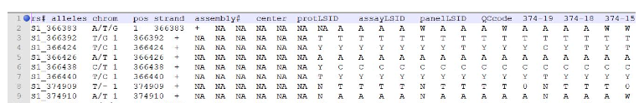
…Data formats
2. Hapmap (Haplotype map) format:
The Hapmap file format is a table which consists of 11 columns is SNPs’ attributes
The follow column are nucleotides observed at each SNP for each individuals with tab split
The first row of the hapmap file is the file’s header and the other rows represents a SNP for each row.
The missing genotype data is “NN” in a hapmap file
Note: You can use tassel software to convert your vcf file to hapmap format. Just open your vcf file in tassel and save it as hapmap format

Slide 21
…Data formats
2. Plink file formats
Bundle of plain text files (PED and MAP dataset or its transpose, TPED & FAM dataset)
Bundle of binary file (BED, BIM and FAM)

Slide 22
Genotyping
Genotyping refers to hybridization of genomic DNA to oligonucleotide probes targeted at a polymorphic region, and the extension of these probes to encompass this region
This extension uses chemically labelled nucleotides that are specific to the different alleles of the polymorphism and that bind either red or green fluorescent agents, which can be read using a fluorescence-sensitive scanner
The end product of genotyping is the raw intensity data of these fluorescent agents at each polymorphic site
The raw intensity data called—clusters, with similar intensities are identified
This initial calling is performed by automated software
However, the algorithms to perform this calling sometimes fail to identify valid clusters, especially when patterns of clustering are unusual
Therefore, some clusters must be identified by manual recalling by a bioinformatician

Slide 23
…Genotyping
Microarrays for common variants or Next generation sequencing (WES or WGS) for rare variants
Genome-wide SNP panels with 10000-5 million SNPs
About 40 types of arrays are developed in past 10 years
Mainly, Affymetrix chips and Illumina-based
Random SNPS
Selected haplotype tag SNPs
Copy number probes
Some arrays allow SNPs to be added
May have to combine studies from different platform
The choice of genotyping platform depends on many factors and tends to be guided by the purpose of the GWAS

Slide 24
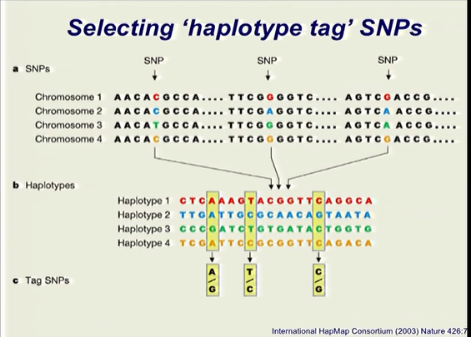
Selecting haplotype tag SNPS
Picture represent 4 copies of particular chromosome with 3 single nucleotide variants
In human history, non-random recombination events have occurred resulting in SNPs getting inherited as clusters, so selecting SNPs that are representative of a larger proportion of variation will reduce the number of SNPs to be selected for the study
Or selecting variants from literature

Slide 25
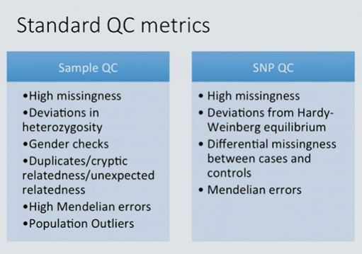
Quality control (identify and remove bad samples)
To make the analysis error free
Is one to remove individuals or markers that have high error rate
As many individuals are genotypes, removal of a handful does not effect overall power of the study

Slide 26
Qualities of bad sample
…Quality control
Poor quality sample
Sample success rate <95%
Excess heterozygous genotype
Sample switches
Wrong sex
Unexpected relation between individuals
Pair-wise comparison of genotype similarity
Duplicates
Ancestry different from rest of the sample

Slide 27
Selecting variants by allele frequency
…Quality control
Filtering the variants by the frequency of the less-common allele (minor allele frequency or MAF)
Rarest variant should be discarded from the analysis
Reason: when variant cluster together, it is difficult to assess if it is from a different genotype or is a missed call
MAF=0.1% is expected to be present in 19 heterozygotes and 1 homozygote in a cohort of 10000 individuals
Smaller cohort: more stringent cut-off (MAF <5%)
Most studies MAF <1%

Slide 28
Minor allele frequency
The frequency at which the second most common allele occurs in a given population
If the MAF is low, it might imply that the major allele for the SNP is conserved and more or less fixed, but not necessarily. This measure gives an idea about the variation of genotypes for a given SNP in a given population, in other words it gives an idea about how common that SNP is
GWAS are typically performed in genetic variants that have common minor allele frequencies (MAFs > 5%).

Slide 29
Removing variants and Samples with missing data
…Quality control
Variants and samples with missing values is removed
Iterative manner: remove variants genotyped in <90% samples
Increase stringency by setting threshold (95-99%)

Slide 30
Assess deviation from Hardy-Weinberg equilibrium
…Quality control
Done to avoid incorrect clustering algorithms due to miscalled variants
threshold for the P -value cut-off can be determined empirically, by examining the spread of P -values from the Hardy–Weinberg test in the data, and selecting a threshold under which there are a greater number of variants than expected by chance

Slide 31
Pruning for LD and removing related samples
…Quality control
Cryptic errors (similarities between individuals) determined by proportion of genome identical-by-descent (IBD) and population stratification
Pruning data before above step using pairwise comparison, comparing each possible pair of variants in a given window of variants and removing one of the pair if the LD between them is above a given cut-off
This protocol uses a window of 1500 variants, shifted by 10% for each new round of comparisons, and a threshold of R 2 > 0.2.
The window size of 1500 variants corresponds to the large, high LD chromosome 8 inversion, while the shift of 10% represents a trade-off between efficiency and thoroughness

Slide 32
…Pruning for LD and removing related samples
…Quality control
Once an LD-pruned data set is obtained, individuals can be compared pairwise to establish the proportion of variants they share identical-by-state (IBS)
Closely related individuals share more of their genome than a randomly chosen pair of individuals from the population, and are likely to be more phenotypically similar
As a result, including closely related individuals can skew analysis; genetic variants shared because of close relatedness can become falsely associated with phenotypic similarity that also results from close relatedness.

Slide 33
…Pruning for LD and removing related samples
…Quality control
With a sufficiently homogeneous cohort assayed at thousands of variants, IBS information can be used to infer variants that are shared identical-by-descent (IBD)
With a sufficiently homogeneous cohort assayed at thousands of variants, IBS information can be used to infer variants that are shared identical-by-descent (IBD) should be removed, as well as individuals with unusually high average IBD with all other individuals, which may indicate sample contamination or genotype recalling error leading to too many heterozygote calls
The IBD threshold suggested here is designed to remove the most closely related individuals, while avoiding removing large numbers of samples through being overly stringent

Slide 34
Confirming sample gender and assessing the inbreeding coefficient
…Quality control
Some samples have been assigned wrong identity of their gender and this leads to reduced power by randomizing genotype w.r.t phenotype
The average homozygosity of variants on the X chromosome (the X-chromosome F statistic) can be used to indicate sample gender
The F statistic is a function of the deviation of the observed number of heterozygote variants from that expected under Hardy–Weinberg equilibrium
In males, F ≈ 1, because all X chromosome variants are hemizygous, and so no heterozygotes are observed
Females are expected to have lower values of F , distributed normally around 0
it is recommended that the <0.2 F threshold for females as used by PLINK
In addition to using a chromosome-specific homozygosity check to confirm gender, a whole-genome F should also be calculated. This statistic is also referred to as an ‘inbreeding coefficient', as inbreeding results in reduced numbers of heterozygotes
Individuals with particularly high or low inbreeding coefficients should be removed from analyses, as this is likely to be an artefact caused by genotyping error

Slide 35
Controlling for population stratification
…Quality control
Similarities exist between the false genotype–phenotype correlations created by close between-sample relatedness and those created by population stratification, where phenotypic and genotypic similarity are correlated because of geographic
most common method to control population stratification is to perform principal component analysis on the genome-wide data, and then use the resulting components as covariates in association analysis.al location, rather than a true association

Slide 36
Population stratification and cryptic relatedness
Can produce spurious associations in case-control studies
Account for or avoid by
Genomic control
Principle components
Family based study design

Slide 37
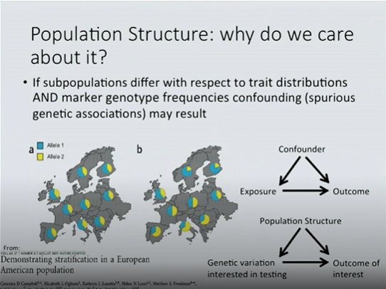
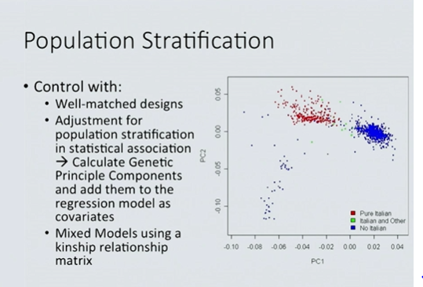
Important confounder in genetic association studies: Population structure

Slide 38
Post imputation: Removing rare or monomorphic variants
In my understanding, monomorphic means something that appears in just one state (or form), in contrast to polymorphic that means something that appears in more than one form. SNPs are by definition polymorphic. A monomorphic site is one site in which all the individuals have the same form (genotype)

Slide 39
Matched ancestry vs Unmatched ancestry
Cases are collected from population but have different underlying ancestry
If the different ancestry is differently represented between cases and control; and the genetic variants are common in a particular subset, then the variants may appear to be associated with the disease but truly they are part of the sub population
Inadequate ancestry information prior to genotyping
Frequency of alleles can help obtain sub populations or population stratification (can cause false positives)

Slide 40
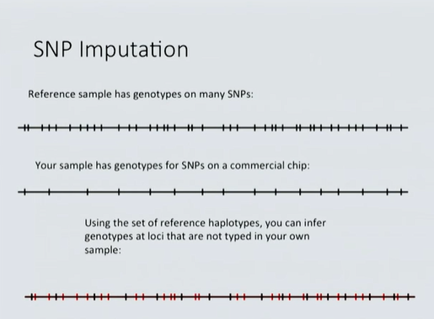
SNP imputation
Imputation panels
HapMap (Can give only common variants)
1000Genome (Larger set of individuals)
Haplotype Reference Consortium from all the sequencing studies so far (Greater number of haplotypes and frequencies)

Slide 41
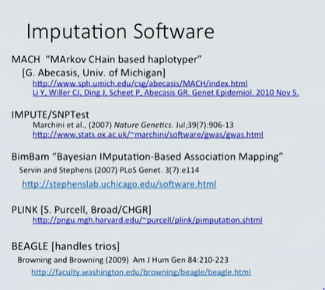
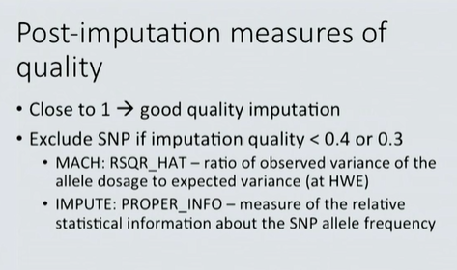

Slide 42
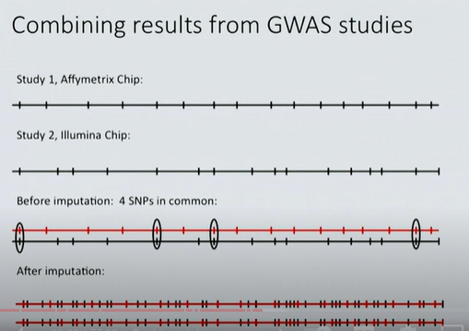

Slide 43
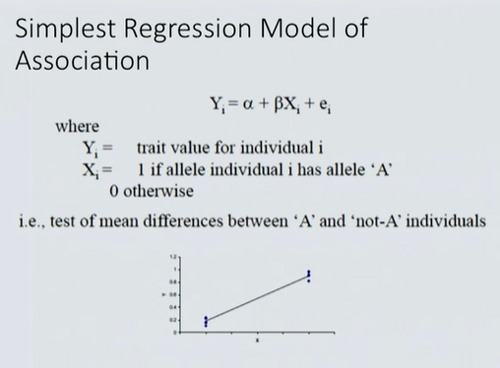
Analysis
SNPi
Testing the trait vaue

Slide 44
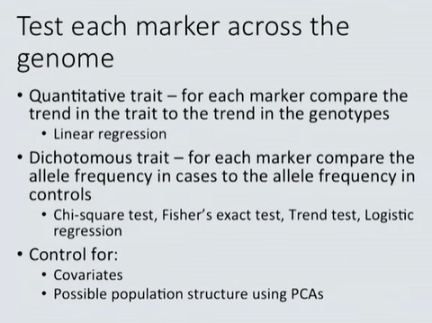

Slide 45
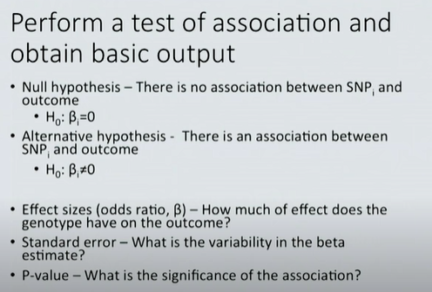

Slide 46
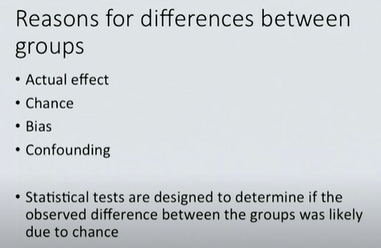
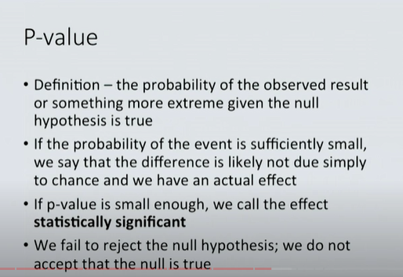

Slide 47
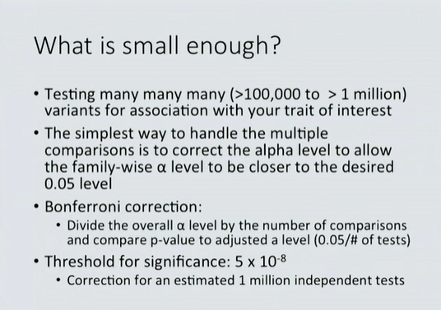
Bonferroni correction

Slide 48
Combining multiple studies
Combined analysis
Combine individual data from multiple cohorts
Often not feasible because of patient confidentiality
Meta-analysis
Combining evidence for association across studies
Can combine test statistics, p-value or effect size estimates (i.e., regression parameters)
Most popular: Inverse variance Weighted meta-analysis (also called “fixed effect” meta-analysis)
It is the weighted average of all the effect estimates from each study, taking precision of effect estimate into consideration
Larger studies are more precise and are given more weight
Smaller studies are less precise and are given less weight
Weights are inversely proportional to standard error squared
Values are obtained as a Z score (should be normally distributed)

Slide 49
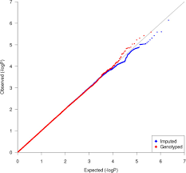
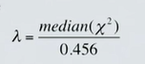
Quantile-Quantile (QQ) plot
Visualizes the overall distribution of p values from an association study
Expercted chi-square statistic on the X-axis (-log 10p value) and the observed value (-log10p value) on the y-axis
Under the null, p-values follow a uniform distribution (45-degree line)
Lambda value is expected to be close to 1 (more sample size, more lambda closer to 1)
Bulk of distribution in lower part of the graph

Slide 50
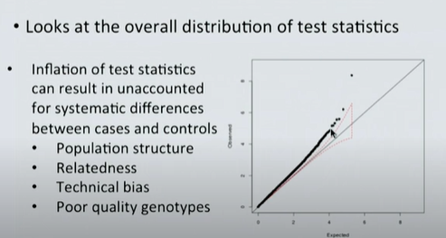
Deviation from qq-plot

Slide 51
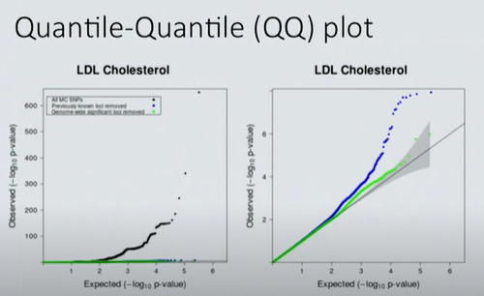

Slide 52
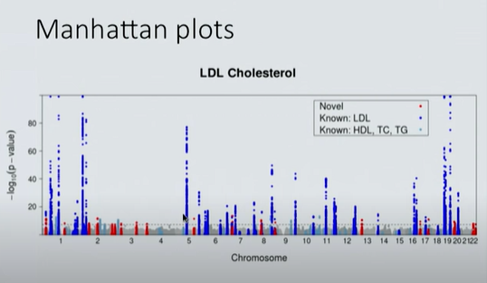
Second way of summarise the distribution of p-values : Manhattan plot

Slide 53
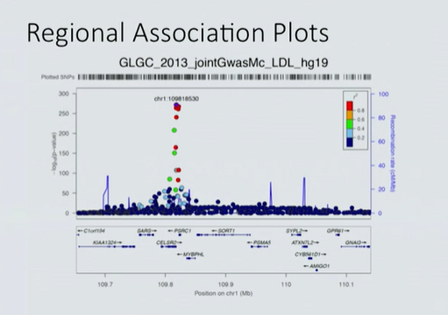

Slide 54
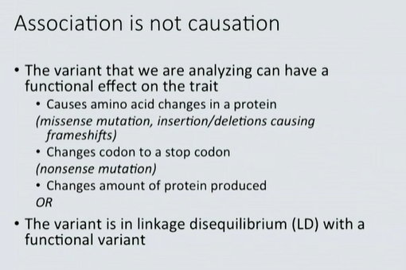

Slide 55
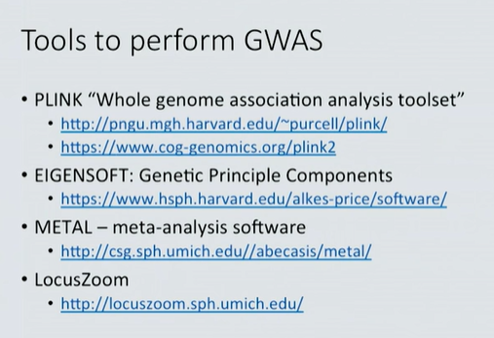

Slide 56
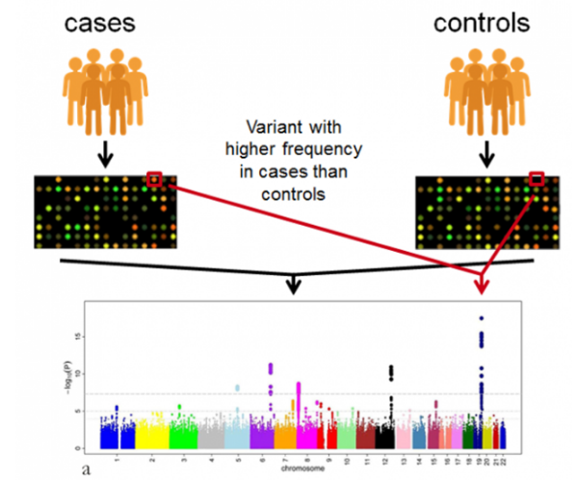
Critical Steps
Identify disease or trait to be studied
Selecting an appropriate study population
Genotyping: SNP arrays
Quality control: Imputation
Association tests: identify regions of genome associated with phenotype of interest

Slide 57
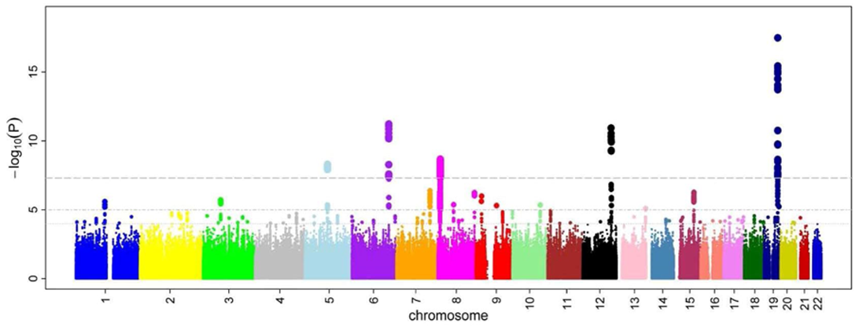
GWAS results are displayed in Manhattan plot
A p-value indicates the significance of the difference in frequency of the allele tested between cases and control
Is the probability that the allele is likely to be associated with the trait

Slide 58
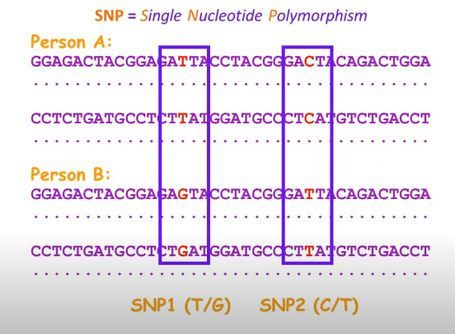
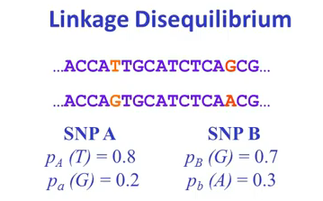
Linkage disequilibrium
When two SNPs are close to each other they are in a situation called Linkage disequilibrium where some haplotypes are more frequent than expected
Haplotype A: TC (from SNP1 and 2)
Haplotype B: GT (from SNP1 and 2)
Haplotype: combination of alleles for different SNPs in the same chromosome

Slide 59
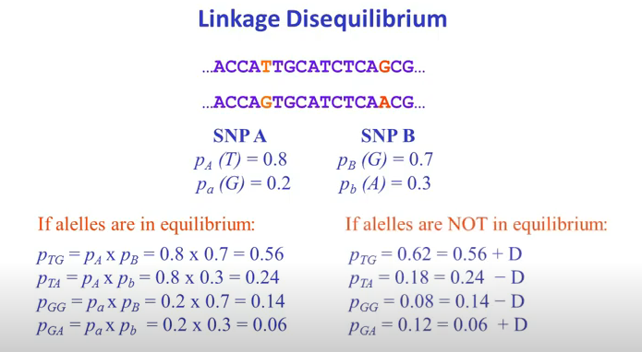
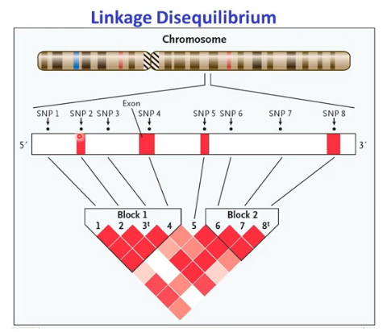
D_{AB} = P_{AB}-P_{A}P_{B}
D is the measure of linkage disequilibrium
Tells how far are the SNPs from each other
8 SNPs near each other
Heat Map representation
Higher the intensity of red, higher the LD

Slide 60
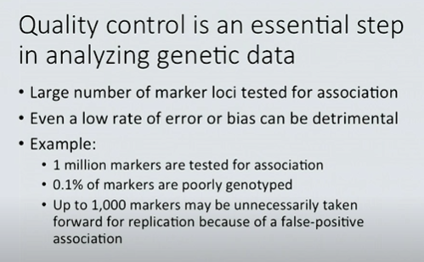
Quality control
Essential step to make the data error free

Slide 61
Resources
https://www.youtube.com/watch?v=xw419NKqMqw&t=3s
https://www.youtube.com/watch?v=HHvdupHgeFg&t=11s

Slide 62
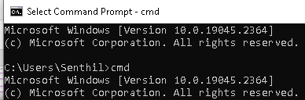
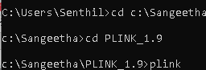
Installing and opening PLINK
Download plink from official website (below), binary downloads section
https://www.cog-genomics.org/plink/
Unpack the zip file on your computer and copy plink.exe to the directory where you want to do the analysis
Navigate to the analysis directory via the command prompt
open command prompt by typing cmd
Use the default drive or change it if different and run the plink.exe program by typing plink

Slide 63
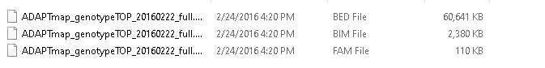
Genotype files for practice in PLINK
File formats: BED, BIM and FAM are binary PLINK formats
Note: All three files have exactly the same name, and differing only in the file extension (so that all three files can be referred using the common name)
These three files belong together, and while individual files alone could give you some information, all three are needed to analyze the data

Slide 64
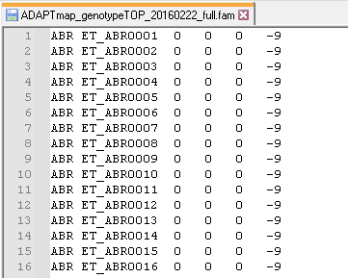
Fam file - Info on individuals
It is just a plain text file with six columns and no header
The first column is the family identification abbreviated as FID
The second column is the "within family ID", which is just simply called "individual ID" and abbreviated as IID
If parents are genotyped their ID in the third and fourth columns. if parents are not known, or at the time of genotyping, it is set to 0
Fifth column is gender information: 1 is for males, 2 for females, and 0 is unknown
The sixth column is to denote the phenotype of the animal in the IID column. Because this is only a single column, only a single phenotype could be specified. In a case-control study the numerical value 1 is reserved for controls, and 2 for the cases. In the case of missing values, you can use zero or minus nine
Number of rows give number of individuals (here , 4653)

Slide 65
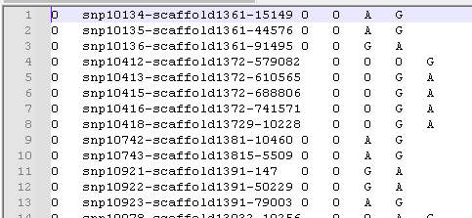
Bim file – SNP location info
Contains locations of all SNPs in the data and number of rows in the .bim file shows how many SNPs are in the data set (Here, 53,347 SNPs)
First column contains chromosome number where the SNP is located
Second column is the SNP name, predefined during the construction of the SNP chip and is fixed
Third column is the position of the SNP in Morgans or centimorgans, with zero if you do not know
The fourth column is base pair coordinate of the SNP. Example: The SNP on the top of the list is on the 109,256,497th position from the start of chromosome 1
Fifth and sixth are the alleles for respective SNPs.
All SNPs on the chips are biallelic by design, so you always see only two alleles in each row.
Therefore, for each SNP there could be only these two characters representing the genotype
The character representing the missing genotypes coded as zero by default
Very important concept that will be relevant to merging SNP data sets
Genotypes in column five usually denote the minor allele and in column six the major allele

Slide 66
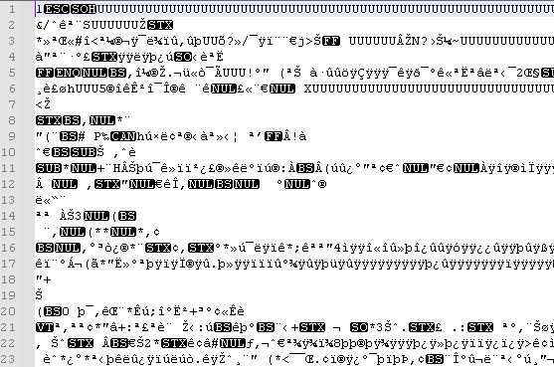
Bed file – Individual genotypes
Not understandable format as it is coded in binary format
It is processed quicker by the computer since it's already translated from human-readable to a machine-readable format
The non-binary file format for the genotype is stored in the so-called ped and map files
These are very well-known file formats and widely used in various programs

Slide 67
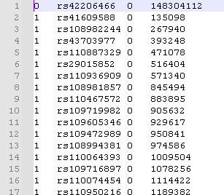
Map file
Variant (SNP) information file with no header line, and one line per variant with the following 3-4 fields
Chromosome code.
Variant identifier
Position in morgans or centimorgans (dummy value '0')
Base-pair coordinate
All lines must have the same number of columns (so either no lines contain the morgans/centimorgans column, or all of them do)

Slide 68

Ped file
The .ped file structure is essentially the concatenation of the .fam file (one line per individual), followed by human-readable genotypes in text in text format, usually above 1GB size
First 6 columns same as fem file
Seventh column onwards, every two columns represent one SNP in a space-delimited format.mat
If both alleles same: Homozygous else Heterozygous
7th column | 8th column | 9th column | 10th column
Allele of SNP1 | Allele of SNP1 | Allele of SNP2 | Allele of SNP2

Slide 69
PLINK COMMANDS
Using PLINK software, binary file format saved as bim, bed and fam should be converted to text-based genotype format such as ped and map files
After the program name, there are various options preceded by a double dash "--"
The PLINK options come in two formats:
--optionName1
--optionName2 space additional Parameter(s)Related To Option Name2

Slide 70
Options used in command in this example
--bfile ADAPTmap_genotypeTOP_20160222_full
This is how you specify that your input file format is a binary ped file
By specifying only the file prefix, the program will automatically utilize everything from the bim, bed, and fam files
--cow This specifies the number of chromosomes in your data set (goat data which has same no of chromosomes as cow)
In case you do not tell anything about chromosome sets, the program will use the human genome as a default setting or –chr-set
--nonfounders is related to bypass any animals with missing parent information being treated as founders
--recode This very simple command is the one that actually does all the work. By putting this in your code you specify that you want to have ped and map files as output
--out ADAPTmap_TOP Specifies the file name for newly created files

Slide 71

Alzheimer’s disease data PLINK in R
Run PLINK: ped to vcf

Slide 72

Create bed files and understand data

Slide 73

Applying QC steps
#Quality control criteria set
##Missingness per SNP: 0.1 --geno
##Missingness per individual: 0.1 --mind
##Minor allele frequency: 0.01 --maf
##Hardy-Weinberg threshold: 0.05 --hwe
## Chr22 (only autosomal SNPs): --chr 1-22
##Cryptic relatedness: 0.2 –min
After QC: (Output of quality controlled genotype data matches with Gplink output)
348967 variants and 364 people pass filters and QC.
Among remaining phenotypes, 176 are cases and 188 are controls.

Slide 74

Principal component analysis (PCA)
Calculating the genetic distances between individuals
(Pairs of genetic distance between each of the individuals)

